Slide 1
KKC PG COLLEGE CHURU ROAD ,SARAR SHAHAR
Aproved by GOVT . Of Rajathan
&
Affiliated to Maharaja Singh University,Bikaner

Slide 2
SH.KISHOR SINGH RATHORE
DIRECTOR
PRINCIPAL
DR. OMPRAKASH BOHARA
HEAD OF DEPARTMENTS
MEHBOOB ALI CHOUHAN (COMPUTER SCIENCE)
PARDEEP CHOUHAN (SCIENCE)
ROOP CHAND PARIHAR (COMMERCE)
CHUNNILAL MAYAL (ARTS)
PUNEET VERMA (EXAM INCHARGE)
VIRENDRA SINGH RATHORE (CTO,NCC)
NARESH KUMAR (NCC TRAINER)
DR. VIMLESH TAILOR (COMPETITION & CARRIER CELL)
JAGDISH (NSS OFFICER-II)
RAJ KUMAR SONI (SPORTS OFFICER)
GOPAL BHAKAR (DISCIPLINE OFFICER)
TILOK CHAND MEGHWAL(RED RABIN CLUB OFFICER)

Slide 3
COURSE OFFERED BY COLLEGE
UNDER GRADUATION (UG) | POST GRADUATION (PG)
Bachelor Of Arts (BA) Bachelor Of Computer Aplication Bachelor Of Science Bachelor Of Commerce | Master of Science ( Computer Science) Master of Science ( Chemistry) Master of Science (Maths) Master of Science ( Physics ) Master of Science ( Botany ) Master of Science (Zoology) Master of Arts (Hindi) Master of Arts ( Geography) Master of Arts ( Drawing & Painting ) PGDCA

Slide 4
SALIENT FEATURES
UGC QUALIFIED FACULTY MEMBERS.
INTERACTIVE CLASSROOMS WITH PROJECTOR.
ONLINE CLASSES FACILITY.
WELL EQUIPPED MODERN LABS.
CAREER COUNSELING AND PLACEMENT ASSISTANCE.
GOVT. SCHOLARSHIPS ASSISTANCE.
NCC,NSS, RED RIBBON CLUB,SCOUT & GUIDE.
INDOOR & OUTDOOR GAMES FACILITY.
COMMUNICATION SKILLS, PERSONALITY DEVELOPMENT & COMPETITION CLASSES.
RICH LIBRARY WITH INTERNET FACILITY.

Slide 5
Topers Class Wise 2020 -2021
S.No. | Class | Name | Father Name | Total | Score | % | Rank
1 | BA - I | ASHISH GIRI | DAYANAND GIRI | 600 | 516 | 86 | FIRST
2 | BA - I | JAI KISHAN SEVDA | LALBAHADUR | 600 | 504 | 84 | SECOND
3 | BA - II | RITIK MANDAL | DINESH MANDAL | 600 | 446 | 74.33 | FIRST
4 | BA -II | DHANESH KANWAR | KESARI SINGH | 600 | 444 | 74 | SECOND
5 | BA -III | RAKSHA JANGIR | VIMAL JANGIR | 600 | 435 | 72.5 | FIRST
6 | BA - III | GAURI SHANKAR SINWAR | HARIRAM | 600 | 431 | 71.66 | SECOND
7 | BCOM - I | SANDEEP | BHAN SINGH | 600 | 360 | 60 | FIRST
8 | BCOM - I | KOMAL SHARMA | ROHITASH SHARMA | 600 | 348 | 58 | SECOND
9 | BCOM II | SUNIL KUMAR SAINI | DEVILAL | 600 | 392 | 65.33 | FIRST
10 | BCOM –II | SAHIL KHOKHAR | SAJID KHOKHAR | 600 | 368 | 61.33 | SECOND
11 | BCOM –III | PRIYANKA BHAMBHU | MULA RAM BHAMBHU | 600 | 443 | 73.83 | FIRST
12 | BCOM -III | DALEEP KUMAR LAKHOTIYA | KAMLESH KUMAR | 600 | 402 | 67 | SECOND
13 | BSC -I | BHAWANI SINGH NARUKA | OMPRAKASH SINGH | 600 | 546 | 91 | FIRST
14 | BSC- I | PRIYANKA SHEKHAWAT | JITENDRA SINGH | 600 | 528 | 88 | SECOND
15 | BSC-II | DHARMENDRA SHARMA | MAHAVEER PRASAD | 600 | 502 | 83.66 | FIRST
16 | BSC -II | SHIV SHAMBHU SANKAR PAREEK | MANOJ KUMAR | 600 | 485 | 80.83 | SECOND
17 | BSC-III | RAKESH KUMAR PAREEK | MAHAVEER PRASAD PAREEK | 600 | 429 | 71.5 | FIRST
18 | BSC-III | SUBHASH CHANDRA | GYANA RAM | 600 | 426 | 71 | SECOND

Slide 6
S.No. | Class | Name | Father Name | Total | Score | % | Rank
19 | BCA -I | MS PRERNA SHARMA | CHUNNI LAL SHARMA | 600 | 480 | 80 | FIRST
20 | BCA-I | KHUSHI SAIN | MANOJ SAIN | 600 | 462 | 77 | SECOND
21 | BCA-II | MS AARTI SONI | HARIOM SONI | 600 | 508 | 84.66 | FIRST
22 | BCA-II | YASH JANGIR | PRAKASH JANGIR | 600 | 491 | 81.33 | SECOND
23 | BCA-III | PUNIT SAINI | KANHIYA LAL SAINI | 600 | 489 | 81.5 | FIRST
24 | BCA-III | KAMLESH | MAHENDRA SWAMI | 600 | 487 | 81.16 | SECOND
25 | PGDCA | CHUNNILAL MAYAL | JAY CHAND RAM MAYAL | 450 | 359 | 79.77 | FIRST
26 | PGDCA | PRIYANKA MEENA | ROHITASH MEENA | 450 | 359 | 79.77 | FIRST
27 | PGDCA | SUNIL KUMAR SHARMA | BHAGAWANA RAM | 450 | 358 | 79.55 | SECOND
28 | MSc (P) CS | BHARAT PANWAR | SAMPAT LAL PANWAR | 450 | 346 | 76.88 | FIRST
29 | MSc(p) CS | HEMANT JOSHI | SHYAM SUNDER JOSHI | 450 | 318 | 70.66 | SECOND
30 | MSc (F) CS | MS KAJAL HUNDLANI | RAMESH CHANDRA | 900 | 758 | 84.22 | FIRST
31 | MSc (F) CS | ANIL KUMAR | RAM CHANDRA | 900 | 690 | 76.66 | SECOND
32 | MSc (P) PHYSIC | ANIL KASWA | AMAR SINGH KASWAN | 450 | 362 | 80.44 | FIRST
33 | MSc (p) PHYSIC | VISHAL SHARMA | NORTMAL BHOJAK | 450 | 354 | 78.66 | SECOND
34 | MSc (F) PHYSIC | SHRAWAN KUMAR PRAJAPAT | BHANWAR LAL | 900 | 678 | 75.33 | FIRST
35 | MSc (F) PHYSIC | DEEPIKA GAHLOT | PAWAN KUMAR | 900 | 644 | 71.55 | SECOND

Slide 7
S.No. | Class | Name | Father Name | Total | Score | % | Rank
36 | MSc (P) CHEMISRTY | PARMESHWAR LAL KEELKA | KHETA RAM KEELKA | 450 | 288 | 64 | FIRST
37 | MSc (F) CHEMISTRY | MS MONIKA PAREEK | BHAIRA RAM PAREEK | 900 | 756 | 84 | FIRST
38 | MSc(F0 CHEMISTRY | BHAVINEE NIRWAN | SUSHIL NIRWAN | 900 | 672 | 74.66 | SECOND
39 | MSc (P) MATHAMATIC | MUKESH KUMAR | RAMDEV AGARWAL | 450 | 318 | 63.6 | FIRST
40 | MSc (P) MATHEMATIC | JAI PRAKASH | KRISHAN KUMAR | 450 | 315 | 63 | SECOND
41 | MSC (F) MATHEMATIC | MS MEERA GODARA | BAJRANG LAL | 900 | 692 | 69.2 | FIRST
42 | MSc (F) MATHEMATIC | WASIM AKRAM | ADARISH | 900 | 650 | 65 | SECOND
43 | MSc (P) BOTANY | VIKAS KUMARI | BRAHMPRAKASH | 450 | 356 | 79.11 | FIRST
44 | MSc(P) BOTANY | UTKARSH | BRAHMPRAKASH | 450 | 353 | 78.44 | SECOND
45 | MSc (F) BOTANY | VIJYA UPADHYAY | MAHAVEER PRASAD | 900 | 756 | 84 | FIRST
46 | MSc (F) BOTANY | PAYAL JANGIR | LAXMI NARAYAN | 900 | 712 | 79.11 | SECOND
47 | MSc (P) ZOOLOGY | SUMAN DANODIYA | SITA RAM | 450 | 332 | 73.77 | FIRST
48 | MSc (P) ZOOLOGY | ANKITA SUTHAR | MADAN LAL | 450 | 327 | 72.66 | SECOND
49 | MA (P) HINDI | MAHAVEER SINGH | NATHU RAM | 450 | 210 | 52.5 | FIRST
50 | MA (F) HINDI | ANJALI MEGHWAL | KHYALI RAM | 900 | 508 | 56.44 | FIRST

Slide 8
SN | CLASS | NAME | FATHER NAME | TOTAL | SCORE | % | RANK
51 | MA (P) GEOGRAPHY | LOKESH MOYAL | JHUMAR MAL MOYAL | 500 | 367 | 73.4 | FIRST
52 | MA (P) GEOGRAPHY | ANITA | BHANWAR LAL | 500 | 349 | 69.8 | SECOND
53 | MA (F) GEOGRAPHY | NIRMALA CHOUDHARY | KESARA RAM SAHARAN | 1000 | 710 | 71 | FIRST
54 | MA (F) GEOGRAPHY | MUKESH KUMAR MAHALA | DHANNA RAM MAHALA | 1000 | 628 | 62.8 | SECOND

Slide 9
CULTURAL & SPORTS ACTIVITIES IN THE COLLEGE
CULTURAL ACTIVITY | SPORTS ACTIVITY
HINDI POEM COMPETITION ENGLISH POEM COMPETITON QUIZ COMPETITION SHORT SPEECH COMPETITON DANCE COMPETITION ESSAY WRITING COMPETITION DRAMA COMPETITION POT MAKING COMPETITION SINGING COMPETITION RANGOLI COMPETITION MEHANDI COMPETITION POSTER MAKING COMPETITION | CHESS CRICKET TABLE TENNIS HIGH JUMP LONG JUMP SHOT PUT DISK THROW KHO KHO KABBADDI VOLLEYBALL BADMINTON RACE WRESTLING JEWELING THROW JUDO QWAN KI DO

Slide 10
PLACEMENT -2021-22
SN | CLASS | NAME | FATHER NAME | POST | COMPANY
1 | BCA | ANSHUMAN SHARMA | SANT LAL SHARMA | PHP DEVELOPER | DAEDAL TECHNOVATION PVT LTD
2 | BCA | NITESH SHARMA | MAHAVEER PRASAED | PHP DEVELOPER | IMG GLOBAL INFOTECH PVT LTD
3 | BCA | RIDHI BAID | RAJ KUMAR BAID | SOFTWEAR ENGINEER | TCS
4 | BCA | PRADEEP RATHORE | RANVEEER SINGH | SOFTWEAR ENGINEER | DOTS SQUARE PVT LTD
5 | BCA | VIKASH JANGIR | RAJ KARAN | SOFTWEAR ENGINEER | DOTS SQUARE PVT LTD
6 | BCA | KARTIK SHEKHAWAT | JANTAR PAL SINGH | SOFTWEAR ENGINER | DOTS SQUARE PVT LTD
7 | BCA | TUSHAR SAIN | VINOD | SOFTWEAR ENGINEER | DOTS SQUARE PVT LTD
8 | MSc (CS) | MANGILAL PRAJAPAT | SITA RAM PRAJAPAT | WEB DEVELOPER | STRIVEMINDZ.COM
9 | BCA | RAJAT MOYAL | JHUMAR MAL MOYAL | SOFTWEAR ENGINEER | DOTS SQUARE PVT LTD
10 | BCA | RAKESH SHARMA | PARSA RAM | SOFTWEAR ENGINER | EMIGEN TECHNOLOGY PVT LTD
11 | BCOM | SHUBHAM SHARMA | KAMAL SHARMA | SALES OFFICER | ICICI BANK
12 | BA | PRADEEP KUMAR PANDIA |  | RELETIONSHIP OFFICER | ICICI BANK

Slide 11
SPORTS ACHIEVEMENT 2021-22
SN | CLASS | NAME | FATHER NAME | GAME | RANK
1 | BA -I | ARVIND SINGH RATHORE | GOPAL SINGH | QWAN KI DO | GOLD MEDAL, UNIVERSITY TEAM SELECTION
2 | BA-I | BANWARI LAL MEGHWAL | KALURAM | WRESTLING | GOLD MEDAL
3 | BA -II | SANDEEP KUMAR | SURAJ RAM | JUDO | BRONZE MEDAL

Slide 12
KPL- VII RESULT 2021-22
SN | CLASS | NAME | FATHER NAME | GAME | RANK
1 | BA -II | VINOD RUHEEL | DEVI LAL | ATHLETICS (M) 100 M | GOLD MEDAL,
2 | BA-II | SUDHEER | AMAR SINGH | ATHLETICS (M) 100 M | SILVER MEDAL
3 | BA -II | SURYA PRAKASH | MANI RAM | ATHLETICS (M) 100 M | BRONZE MEDAL
4 | BA -I | SARITA SARAN | DEV KARAN SARAN | ATHLETICS (W) 100 M | GOLD MEDAL
5 | BSc -II | LALITA GODARA | BAJRANG LAL | ATHLETICS (W) 100 M | SILVER MEDAL
6 | BA-II | MANISHA JAKHAR | NAND LAL JAKHAR | ATHLETICS (W) 100M | BRONZE MEDAL
7 | BA -II | LAL CHAND JAT | SANWAR MAL JAT | ATHLETICS (M) 200 M | GOLD MEDAL
8 | BA- II | RAMA KISHAN SARAN | IMARATA RAM | ATHLETICS (M) 200 M | SILVER MEDAL
9 | BA -I | SANDEEP KUMAR VERMA | HANUMAN | ATHLETICS (M) 200 M | BRONZE MEDAL
10 | BA -I | SARITA SARAN | DEV KARAN SARAN | ATHLETICS (W)200M | GOLD MEDAL
11 | BA-II | MANISHA JAKHAR | NANDLAL JAKHAR | ATELETICS (W) 200 M | SILVER MEDAL
12 | BA-II | RACHANA GODARA | BAJRANG LAL | ATHLETICS (W) 200 M | BRONZE MEDAL

Slide 13
SN | CLASS | NAME | FATHER NAME | GAME | RANK
13 | BA -I | DEV KARAN | IMRATA RAM | ATHLETICS (M) 400 M | GOLD MEDAL
14 | BA-I | SANDEEP KUMAR VERMA | HANUMAN | ATHLETICS (M) 400 M | SILVER MEDAL
15 | BA -II | VINOD RUHEEL | DEVI LAL | ATHLETICS (M) 400 M | BRONZE MEDAL
16 | BA -I | SARITA SARAN | DEV KARAN SARAN | ATHLETICS (W) 400 M | GOLD MEDAL
17 | BSc -II | RACHANA GODARA | BAJRANG LAL | ATHLETICS (W) 400 M | SILVER MEDAL
18 | BA-II | SUMAN BHOBHIYA | KESHARI RAM | ATHLETICS (W) 400 M | BRONZE MEDAL
19 | BA -I | ARJUN NATH | HOSHIYAR NATH | JAVELIN THROW | GOLD MEDAL
20 | BSc- III | LAL CHAND DHAKA | RAM LAL | JAVELIN THROW | SILVER MEDAL
21 | BA -I | ARJUN NATH | HOSHIYAR NATH | LONG JUMP (M) | GOLD MEDAL
22 | BA -I | SANDEEP KUMAR | HANUMAN | LONG JUMP (M) | SILVER MEDAL
23 | BA-II | KISHAN LAL SWAMI |  | LONG JUMP (M) | BRONZE MEDAL
24 | BA-I | SUSHILA CHAHAR | MEGHA RAM | LONG JUMP (W) | GOLD MEDAL
25 | BA –II | RACHANA GODARA | BAJRANG LAL | LONG JUMP (W) | SILVER MEDAL
26 | BA-II | MANISHA JAKHAR | NAND LAL | LONG JUMP (W) | BRONZE MEDAL
27 | BA -II | RACHANA GODARA | BAJARANG | HIGH JUMP (W) | GOLD MEDAL
28 | BA-I | SUSHILA CHAHAR | MEGHA RAM | HIGH JUMP (W) | SILVER MEDAL
29 | BA-I | SARITA SARAN | DEV KARAN SARAN | HIGH JUMP (W) | BRONZE MEDAL

Slide 14
SN | CLASS | NAME | FATHER NAME | GAME | RANK
30 | BA -II | MUKESH KHAYALIYA | LADURAM | KAIRAM | WINNER
31 | MA (F) GEOGRAPHY | ABHISHEK AGARWAL | GHANSHYAM | KAIRAM | RUNNER -UP
32 | BSc-III | VISHAL RAJPUROHIT | RAJU SINGH | CHESS | WINNER
33 | MSc (F) CS | AJAY KUMAR RAIGAR | PARBHU DAYAL RAIGAR | CHESS | RUNNER -UP
34 | BA-II | MANISHA JAKHAR | NAND LAL | BADMINTON (W) | WINNER
35 | BA -I | SUMAN KUMARI | KISHAN LAL | BADMINTON (W) | RUNNER-UP
36 | BA-II | VISHAL PAREEK | CHAINPRAKASH PAREEK | BADMINTON (M) | WINNER
37 | BA- I | ARJUN NATH | HOSHIYAR NATH | BADMINTON (M) | RUNNER-UP
38 | BA-II | SURYAPRAKASH (CAPTAIN) | MANIRAM GODARA | KABADDI | WINNER TEAM MEMBER
39 | BA -II | VINOD RUHEEL | DEVI LAL | KABADDI | WINNER TEAM MEMBER
40 | BA-II | SURYA PRAKASH SAINI | GOPI CHAND SAINI | KABADDI | WINNER TEAM MEMBER
41 | BA-II | JAYAD KHAN | AHMAD KHAN | KABADDI | WINNER TEAM MEMBER
42 | BA-II | ASHOK MEGHWAL | JAGDISH PRASAD | KABADDI | WINNER TEAM MEMBER
43 | BA-III | IKRAM | IRSHAD KHAN | VOLLYBALL | WINNER TEAM MEMBER
44 | BA-III | ALI | IKBAL KHAN | VOLLYBALL | WINNER TEAM MEMBER
45 | BA-III | MOSIM KHAN | GAFUR KHAN | VOLLYBALL | WINNER TEAM MEMBER
46 | BA-III | FARESH KHAN | AYUB KHAN | VOLLYBALL | WINNER TEAM MEMBER

Slide 15
KPL- VII RESULT 2021-22
SN | CLASS | NAME | FATHER NAME | GAME | RANK
51 | BA-II | JAVED HUSSAIN | YUNUSH HUSSAIN | CRICKET | WINNER TEAM MEMBER
52 | BA-II | SURYA PRAKASH GODARA | MANIRAM | CRICKET | WINNER TEAM MEMBER
53 | BA-II | TOFIK KHAN | JANGSHER KHAN | CRICKET | WINNER TEAM MEMBER
54 | BA-III | RITIK MANDAL | DINESH MANDAL | DRAWING & PAINTING | WINNER
55 | BA-III | DHANESH KANWAR | KESHARI SINGH | DRAWING & PAINTING | RUNNER –UP
56 | BA -II | SHALU JAKHAR | MEGHRAJ | QUIZ COMPETITION | WINNER
57 | BA-II | VISHAL PAREEK | CHAI PRAKASH PAREEK | UIZ COMPETITION | RUNNER-UP
58 | BA-I | JYOTI KANWAR | UMMED SINGH | ESSAY WRITING | WINNER
59 | BA-II | RITIK MANDAL | DINESH MANDAL | ESSAY WRITING | RUNNER-UP
60 | BA-I | KUMARI SONU | OMPRAKASH | ESSAY WRITING | RUNNER-UP

Slide 16
SN | CLASS | NAME | FATHER NAME | GAME | RANK
47 | BA-I | TOSIB KHAN | MUSTAK KHAN | VOLLYBALL | WINNER TEAM MEMBER
48 | BA-III | AASIB KHAN | MODIDEEN KHAN | VOLLYBALL | WINNER TEAM MEMBER
49 | BA-I | AJIJ KHAN | ALADEEN KHAN | VOLLYBALL | WINNER TEAM MEMBER
50 | BA-I | MANISH KUMAR | BHUPRAM | VOLLYBALL | WINNER TEAM MEMBER
51 | BA-II | VIKAS RATHORE © | RAJKUMAR RATHORE | CRICKET | WINNER TEAM MEMBER
52 | BA-II | SOYAL KHATRI | YAKUB KHATRI | CRICKET | WINNER TEAM MEMBER
53 | BA-II | TARACHAND NAI | DEVILAL NAI | CRICKET | WINNER TEAM MEMBER
54 | BA-II | VISHAL PAREEK | CHAINPRAKASH PAREEK | CRICKET | WINNER TEAM MEMBER
55 | BA-II | NARENDRA SINGH | VINOD SINGH | CRICKET | WINNER TEAM MEMBER
56 | BA-II | SUFIYAN KHATRI | SAJID KHATRI | CRICKET | WINNER TEAM MEMBER
57 | BA-II | NANDRAM SAINI | MULCHAND | CRICKET | WINNER TEAM MEMBER
58 | BA-II | LAL CHAND JAKHAR | SANWARMAL JAKHAR | CRICKET | WINNER TEAM MEMBER
59 | BA-II | ZAHEED HUSSAIN | IBRAHIM HUSSAIN | CRICKET | WINNER TEAM MEMBER

Slide 17
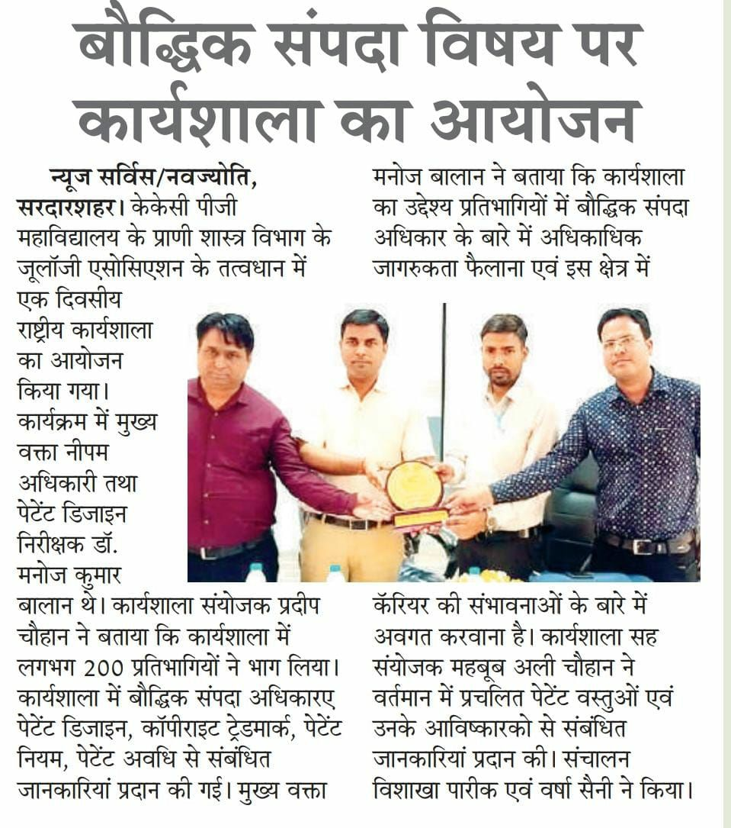
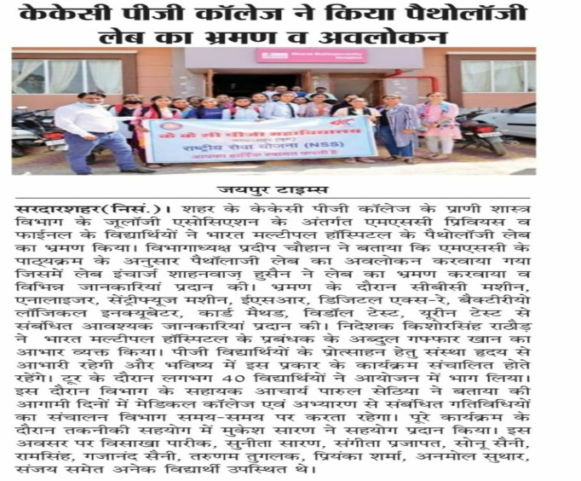
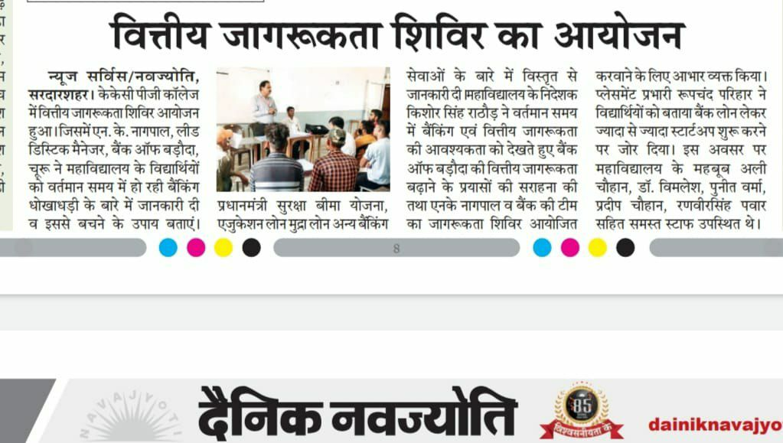
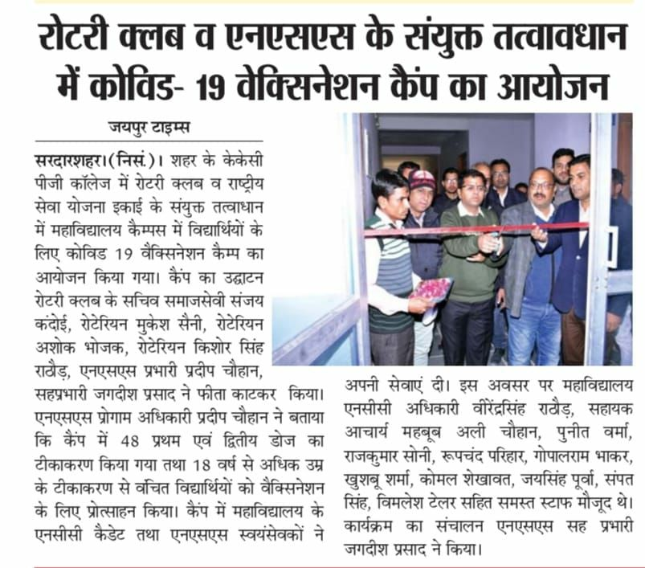
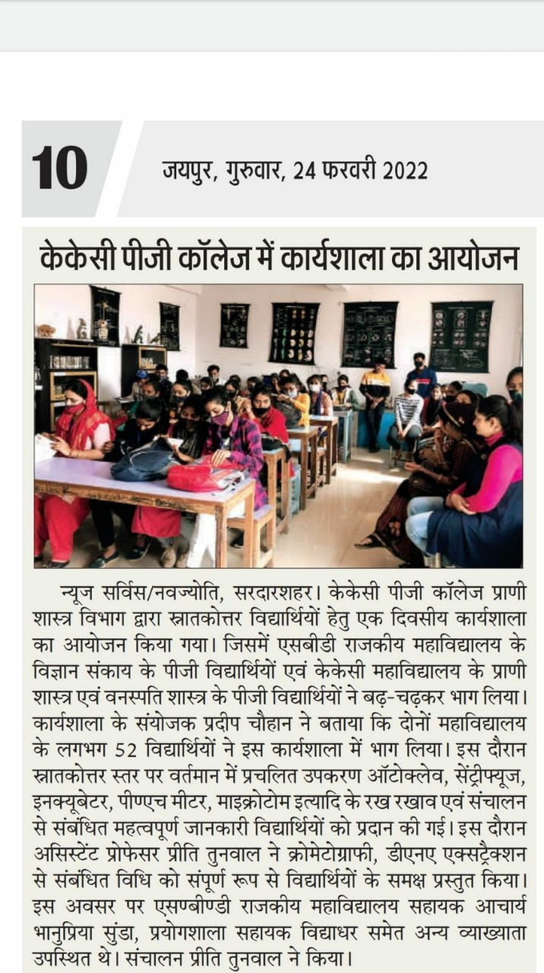
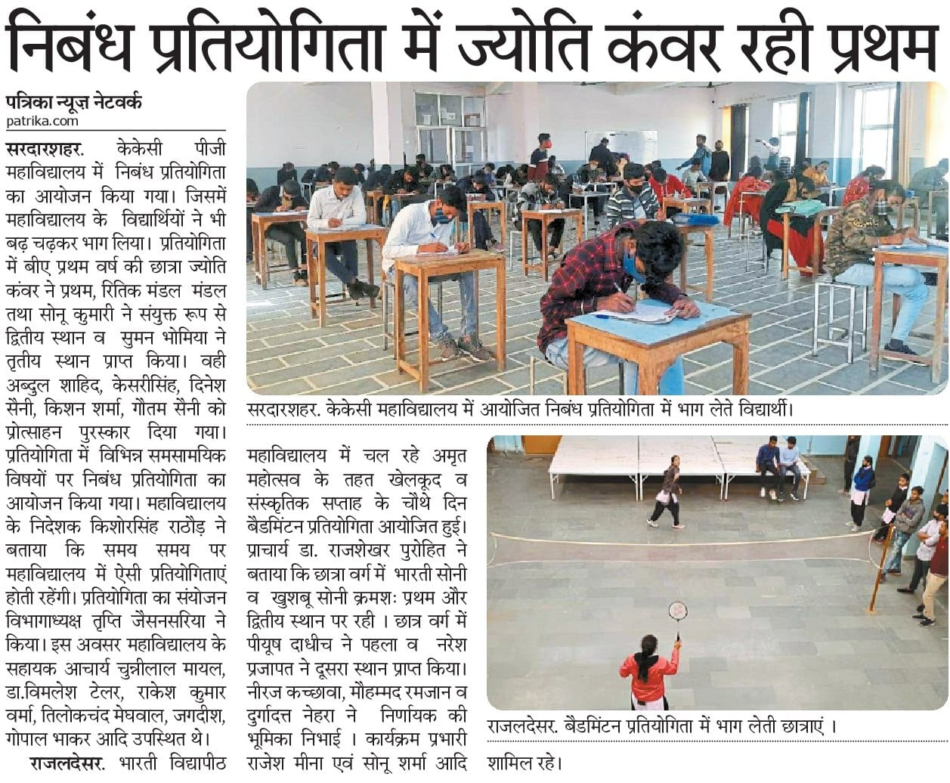
NEWS GALLERY

Slide 18
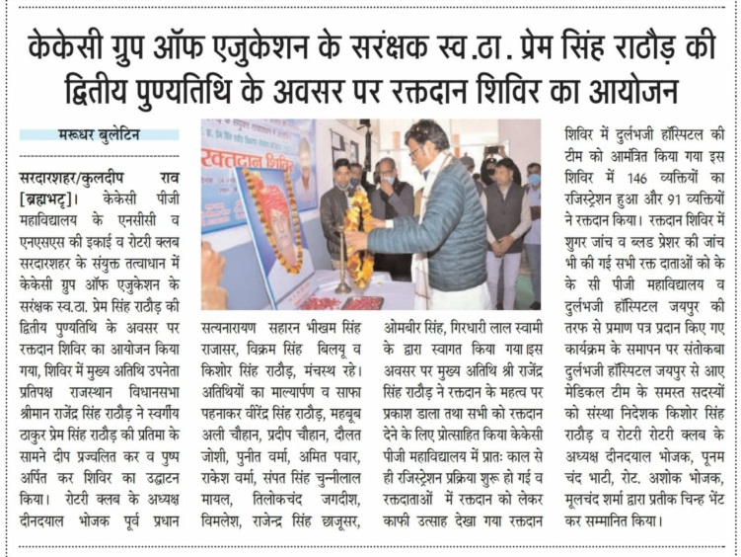
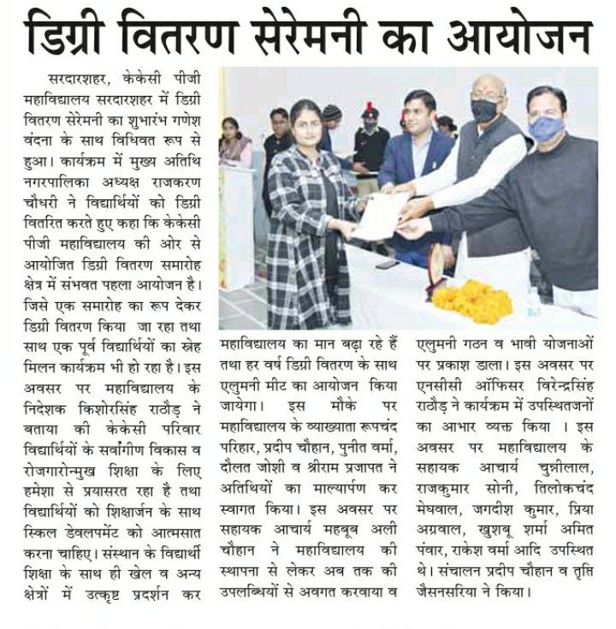
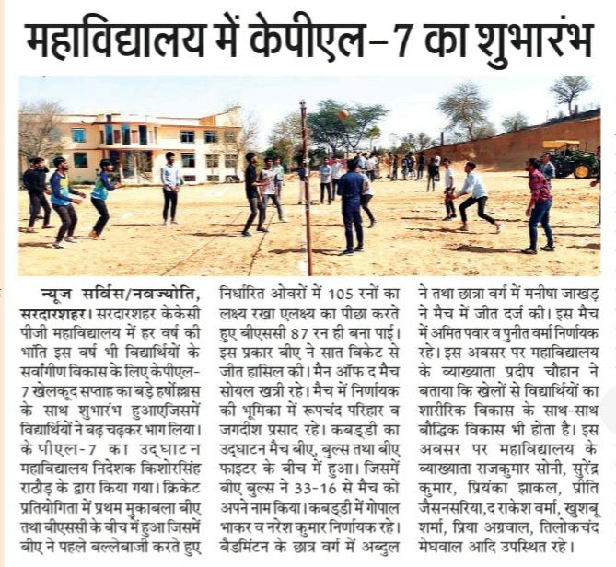
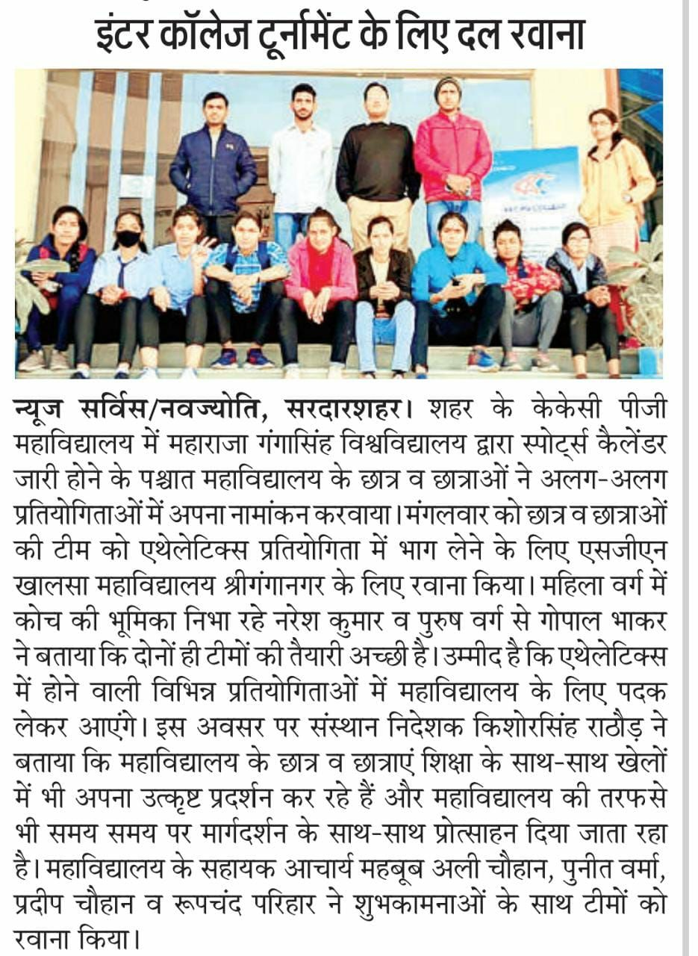
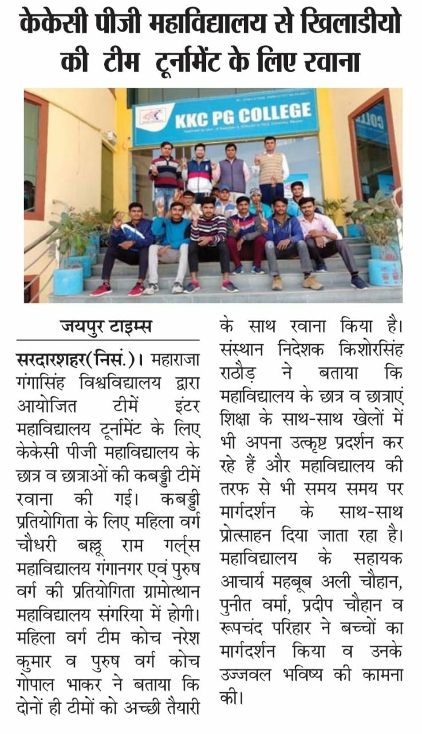
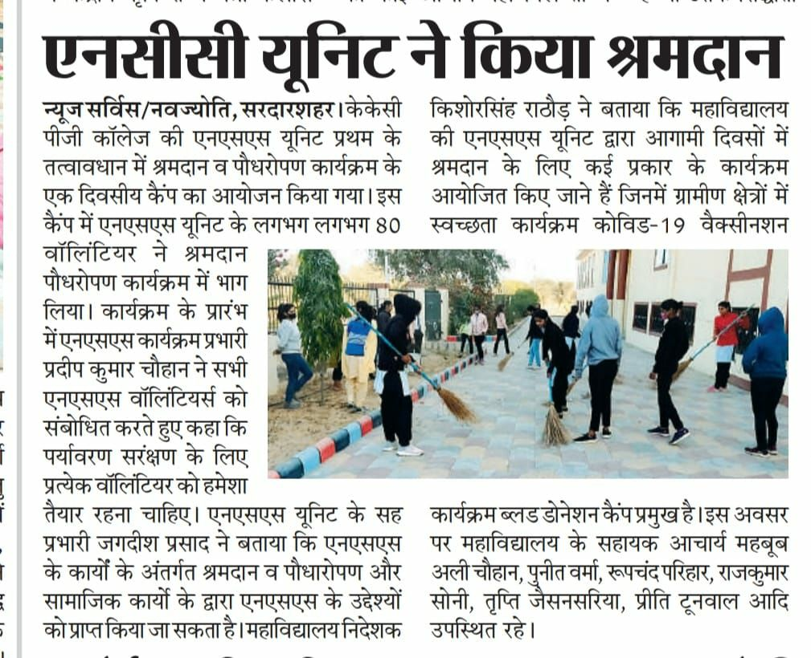
NEWS GALLERY

Slide 19
THANK YOU
FOR
WATCHING

